Slide 1



Web programming with JS
By Elham Jaffar

Slide 2
javascript
JavaScript is a scripting or programming language that allows you to implement complex things on web pages - It was created by Brendan Eich in 1995

Slide 3
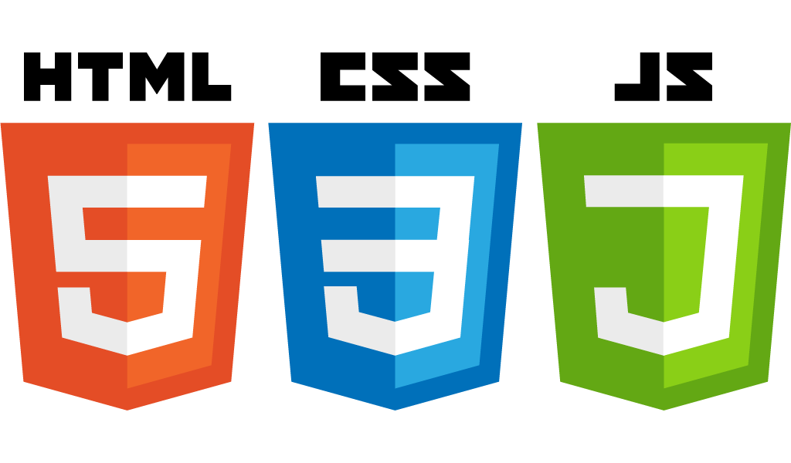
Why JavaScript?
Contents & Structure
Heading Lists Paragraphs
Presentation
Font Color Border
Behavior
Dynamic Display Pop windows User Interaction

Slide 4

Object-oriented programming
Object-oriented programming (OOP) is a programming paradigm based on the concept of "objects", which may contain data, in the form of attributes; and code, in the form of methods.
Class: Vehicle
Properties
Color
Model
Year
Methods
Stop
Strat
Object: Car

Slide 5
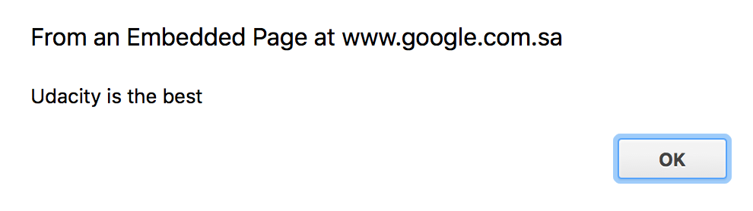
alert
Usage: The alert() method displays an alert box with a specified message and an OK button.
window. alert("Udacity is the best");
Display Message in alert box

Slide 6

Console log
Outputs a message to the Web Console.
console. log("Udacity is the best");
Display Message in console

Slide 7

What is a Data type?
The data type of a value (or variable in some contexts) is an attribute that tells what kind of data that value can have.
Data
Memory

Slide 8
Primitive Data types
Number
String
Undefined
Null
Boolean

Slide 9
1- Number
Integer ex: 3
Decimal ex: 3.1
Note that numbers in JavaScript are written without double quotation

Slide 10
1- Number
Arithmetic Operators Arithmetic Operator take numerical values (either literals or variables) as their operands and return a single numerical value.
Addition ex: 3+2
Subtraction ex: 7-4
Multiplication ex: 2*8
Division ex: 10/2

Slide 11
1- Number
Order of Operations We should evaluate expression according to the order of operations.
P
Pranthesis
E
Exponent
M or D
Multiplication or Division (Left to Right)
A or S
Addition or Subtraction (Left to Right)

Slide 12
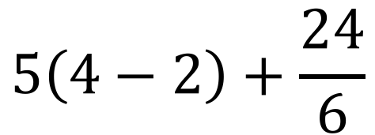
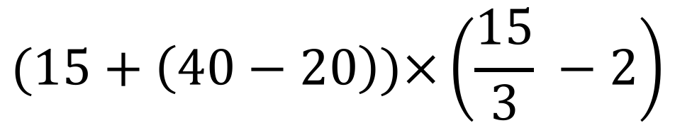
Evaluate an expression exercise
$$5\left(4−2\right)+\frac{24}{6}$$
$$(15+\left(40−20\right))×\left(\frac{15}{3} −2\right)$$

Slide 13
2- String
It is a a series of characters between a double quotation “Content”
String Concatenation:
Ex: “I love” + “Udacity”
Everything inside a double quotation means String Ex: “Hi + (5*2)” → results: Hi + (5*2)

Slide 14
3- Undefined
A variable without a value
Ex: var car;
Console.log(car); Because there is no value assigned to car, the line results Undefined

Slide 15
4- Null
Null is "nothing". It is supposed to be something that doesn't exist.
How to use Null? ex: var person = null; Note: typeof Null in JS is Object

Slide 16
5- Boolean
Booleans can only have two values: true or false. Everything Without a "Value" is False
Ex 1: var x = ""; Boolean(x); // returns false Ex 2: var x = 0; Boolean(x); // returns false

Slide 17
5- Boolean
Logical Operators Logical operators are used to determine the logic between variables or values.
AND ex: console.log(x == y && x > y); result: false
OR ex: console.log(x == y || x > y); result: true
Not ex: console.log(!(x == y)); result: true
var x = 2; var y = 1;

Slide 18
5- Boolean
Logical Operators
AND (&&)
Value 1 | Value 2 | Expression | Result
true | true | (2==2) && (3==3) | true
false | true | (2!=2) && (3==3) | false
true | false | (2==2) && (3!=3) | false
false | false | (2!=2) && (3!=3) | false
OR (||)
Value 1 | Value 2 | Expression | Result
true | true | (2==2) || (3==3) | true
false | true | (2!=2) || (3==3) | true
true | false | (2==2) || (3!=3) | true
false | false | (2!=2) || (3!=3) | false

Slide 19
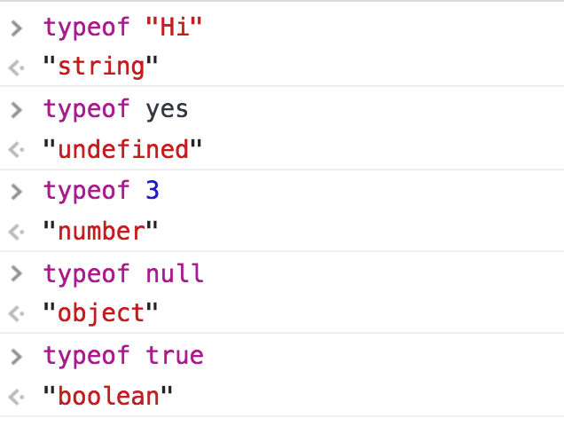
There are other data types!
We will talk about Non-primitive data types later on!
The typeof operator returns a string indicating the type of the unevaluated operand.

Slide 20

Comments
JavaScript comments can be used to explain JavaScript code, and to make it more readable. Any text between // and the end of the line or between /* */ will be ignored by JavaScript (will not be executed).
Single line comments start with //
Multi-line comments start with /* and end with */

Slide 21
Comments
Single Line Comment
Ex:
// Change heading: document.getElementById("myH").innerHTML = "My First Page"; Multi Line Comment
Ex:
/* The code below will change the heading with id = "myH" and the paragraph with id = "myP" in my web page: */ document.getElementById("myH").innerHTML = "My First Page"; document.getElementById("myP").innerHTML = "My first paragraph.";

Slide 22
variables
JavaScript variables are containers for storing data values.
Content
Storage Address
var x = 5;
5
123450
123451
123452
123453
123454
123455
x
Variable Keyword
Variable Value
Memory

Slide 23
Variable’s data types
JavaScript is a loosely typed or a dynamic language. Variables in JavaScript are not directly associated with any particular value type, and any variable can be assigned (and re-assigned) values of all types.
Example:
var foo = 42; // foo is now a Number var foo = 'bar'; // foo is now a String var foo = true; // foo is now a Boolean

Slide 24
Naming Variables Rules
The first character must be an ASCII letter (either uppercase or lowercase), or an underscore (_) character. Note that a number cannot be used as the first character.
Subsequent characters must be letters, numbers, or underscores (_).
The variable name must not be a reserved word.
If the variable name consist of 2 words, start the second word with capital letter (don’t use space)

Slide 25
Naming Variables Exercise
Which of the following statements have a valid variable name ?
var 5firstVariable = 3;
var variable2 = true;
var _firstVariable = 3;
var first Variable = ”hi”;
var undefined = true;
var if = ”4”;
var firstVariable = ”hi”;

Slide 26
More about String

Slide 27
Access Char in a String
Each Character has an index
Length = 7 char
UDACITY
0123456
First index
Last index length-1

Slide 28
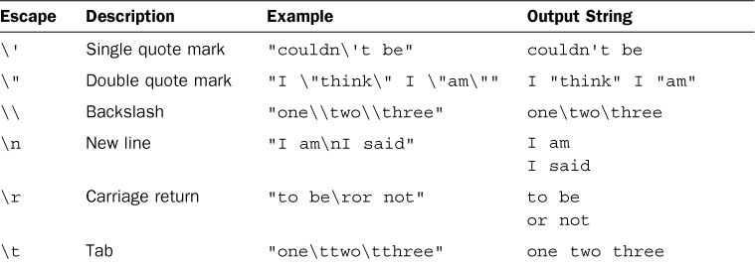
Escape String

Slide 29
Compare Strings
Case Sensitive
Ex: “no” == “No” → result: false Use strict quality (===) or (!==) No type conversion is done, and the types must be the same to be considered equal. Ex: true == 1; //true, because 'true' is converted to 1 & then compared true === 1; //false

Slide 30
Increment & Decrement
var i =2; i++; ++i; i--; --i;
What are the differences between them ?

Slide 31
Comparing types
NULL No Value Ex: var x = null
UNDEFINED Absence of Value Ex: var x; console.log(x); no value has assigned
NaN Not a Number Ex: "s" * 2; Use a string as a number

Slide 32
functions

Slide 33
Functions
It is a block of code designed to perform a particular task.
It is executed when "something" invokes it (calls it).
It is defined with the function keyword, followed by a name, followed by parentheses ().
function functionName(parameter){
//code to be executed
}

Slide 34
Functions
It is a block of code designed to perform a particular task.
It is executed when "something" invokes it (calls it).
It is defined with the function keyword, followed by a name, followed by parentheses ().
It can have zero, 1 or more parameters.
function welcome (){
Console.log(“Hi”);
}

Slide 35
Functions & Return statement
The return statement stops the execution of a function and returns a value from that function.
Make sure you store the function return value in a variable. HOW ??
function myFunction(name) { return "Hello " + name; }
Call a function
var welcomeMsg = myFunction(“Elham”); console.log(welcomeMsg );

Slide 36
Non-Primitive data types

Slide 37
Array
Arrays are used to store multiple values in a single variable. * Note: Array data type is Object Declaring Array:
var books = [”book1”, “book2”, “book3”];
Index
Array Content
Content
Storage Address
0
1
2
“book1”
”book2”
“book3”
Books
123450
123451
123452
123453
123454
123455

Slide 38
Array & index
Each element inside an array has an index:
Length = 3 elements
var books = [”book1”, “book2”, “book3”];
First index 0
Last index length-1 2

Slide 39
Array & index
Access an element by using its index.
var books = [”book1”, “book2”, “book3”]; console.log(books[1]); result: book2

Slide 40
Array Functions
Push() → Add an element to the end of array
Pop() → Remove last element
Length → Return array length
Splice() → changes the contents of an array by removing existing elements and/or adding new elements. Let’s try them ☺
External Resource!

Slide 41
Object
Any object in real life ! Let’s bring back our car example!
Class: Vehicle
Priorities
Color
Model
Year
Methods
Stop
Strat
Object: Car
Declaring Object:
var car = {
color: “blue”, model: “BMW”, year:2018, stop: function(){ console.log(“stop the car”); }, start: function(){
console.log(“strat the car”); }
}
var objectName = { key: value};

Slide 42
Object
var car = {
color: “blue”, model: “BMW”, year:2018, stop: function(){ console.log(“stop the car”); }, start: function(){
console.log(“strat the car”); }
}
Access a property of an object
Dot Notation car.year; result: year
Bracket Notation car[“year”]; result:year

Slide 43

Ready to write a JS program?

Slide 44
Conditional Statements

Slide 45

Conditionals Statements
Comparison operators can be used in conditional statements to compare values and take action depending on the result
If-else
If-else if … else
Switch-case
How can I use them ?? When should I use them?

Slide 46
If-else
Purchase item from the store
var money = 100; var item = 20; if (money>=item){
console.log(“Buy the item”); } else{ console.log(“Don’t buy the item”); }
Do I have enough money?
Yes
Buy the item
No
Don’t buy the item

Slide 47
If-else if ….. else
Purchase one of the items from the store
var money = 100; var item1 = 120; var item2 = 80; if (money>=item1){
console.log(“Buy item1”); } else if(money>=item2){ console.log(“Buy item2”); } else{ console.log(“Don’t buy the item”); }
Do I have enough money to buy item1?
Yes
Buy item1
No
Do I have enough money to buy item2?
Yes
Buy item2
No
Don’t buy the item

Slide 48
Switch-case
switch (new Date().getDay()) { case 0: day = "Sunday"; break; case 1: day = "Monday"; break; case 2: day = "Tuesday"; break; case 3: day = "Wednesday"; break; case 4: day = "Thursday"; break; case 5: day = "Friday"; break; case 6: day = "Saturday"; break; default: day = ”error"; }

Slide 49
Switch-case Tips
Switch-case
Avoid falling through when you forget break statements.
Always add default part to catch an error or bad case.
Use the switch statement to select one of many blocks of code to be executed.

Slide 50
Conditional statement Exercise
If the current time (HOUR) is less than 12:00: Print in console “Good Morning”.
If the current time (HOUR) is greater than or equal 12:00 and less than or equal 15:00 Print in console “Good Afternoon”.
If the current time (HOUR) is greater than 15:00 and less than 18:00 Print in console “Good Day”.
For other (Hours) Print in console “Good Evening”.
var time = new Date().getHours();
To get current hour from the computer

Slide 51
Loops

Slide 52
Loops
Loops can execute a block of code a number of times.
while
for
forEach

Slide 53
While loop
The while loop loops through a block of code as long as a specified condition is true.
Syntax
Example
while (condition) { //code block to be executed }
var num = 10; while (num >0) { console.log(“it is a posstive number”); //this is the condition to stop the loop num--; }

Slide 54
For loop
The for loop loops through a block of code a number of times
Syntax
for (start statement; stop statement; update statement) { //code block to be executed }
Example
for (var num=10; num>0; num--){ console.log(“it is a posstive number”); }

Slide 55
ForEach
The for each iterates a specified variable over all values of object's properties.
Syntax
forEach (variable in object) {
//statement
}
Example
var sum = 0;
var obj = {prop1: 5, prop2: 13, prop3: 8};
forEach (var item in obj) {
sum += item;
}
console.log(sum);

Slide 56
Loop Exercise
Write a JavaScript for loop that will iterate from 0 to 15. For each iteration, it will check if the current number is odd or even, and display a message to the console.
Hint: Use Reminder Operator %.

Slide 57
Other important topics
Scopes
Hoisting
Nested Loop & 2D array
Continue & Break statements

Slide 58
Working on first project

Slide 59

Remember that we are here to help you
All you have to do is ASK!
Thank you for Attending

